Slide 1
Default Project: Fake News Classification
Venkata Sai Goutham Gonuguntla - A20450688
Rishikesh Jangam – A20448930

Slide 2
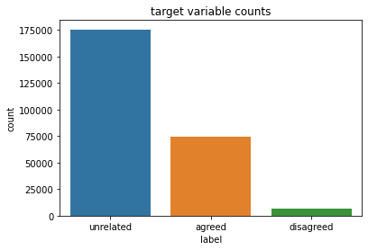
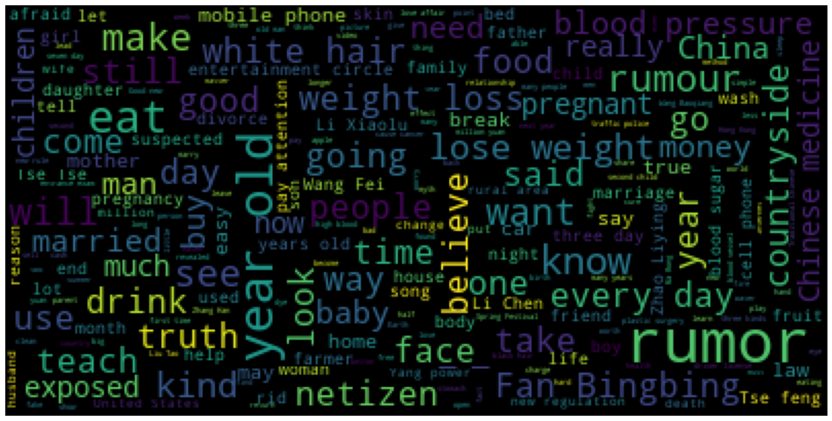
Understanding Data
WordCloud:
Target value label Distribution

Slide 3
Data Pre-processing
Concatenated two columns(Title1 and Title2)
TF-IDF Vectorizer
Removed Stop words, punctuations, numbers.
No Null Values.
Encoded Target variable to 0,1,2 for Unrelated, Agree and Disagree.

Slide 4
Model Building
Hyper Parameters
Metrics – Accuracy
Loss – Cross Entropy
Train Test Split with 70% and 30%.
Performed 5 – fold Cross Validation for different models.
Xgboost
Light Gradient Boosting
Naive Bayes
Logistic Regression

Slide 5
Results
Model | Score
Logistic Regression | 0.69
XGBoost | 0.79
LightGBM | 0.78
Naive Bayes | 0.76

